Slide 1
UEFI boot flow to OS selection on Arm Based SoCs
Fall 2017 UEFI Seminar and Plugfest
October 30 – November 3, 2017
Presented by:
Wasim Khan (NXP Semiconductors)
Notes:
.

Slide 2

Agenda
Introduction
Things
Stuff
Other Things
Final Stuff
Questions about Stuff

Slide 3
OS Image Selection

Slide 4
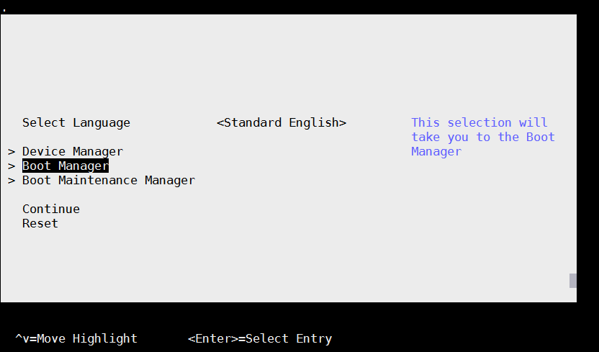
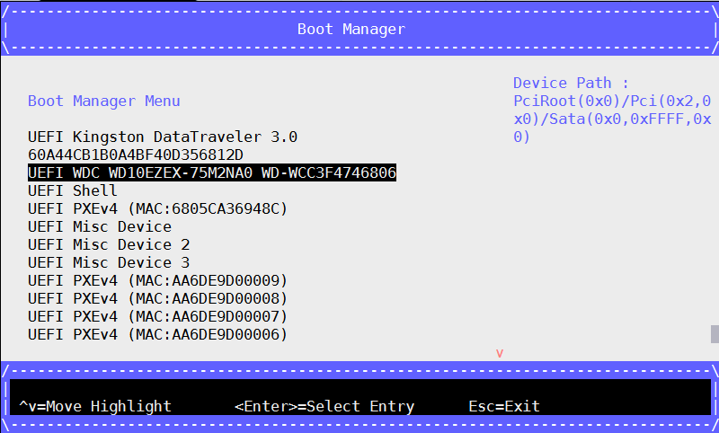
UEFI Boot Manager and Boot Menu
UEFI Boot manager will try to boot from all entries as they appear in UEFI boot menu.
The boot order list is read from a globally defined NVRAM variable.
The variable also contains a pointer to the hardware device and to a file on that hardware device that contains the UEFI image to be loaded.
Supports different boot methods like Network Boot (PXE), Boot from removable media device etc.

Slide 5
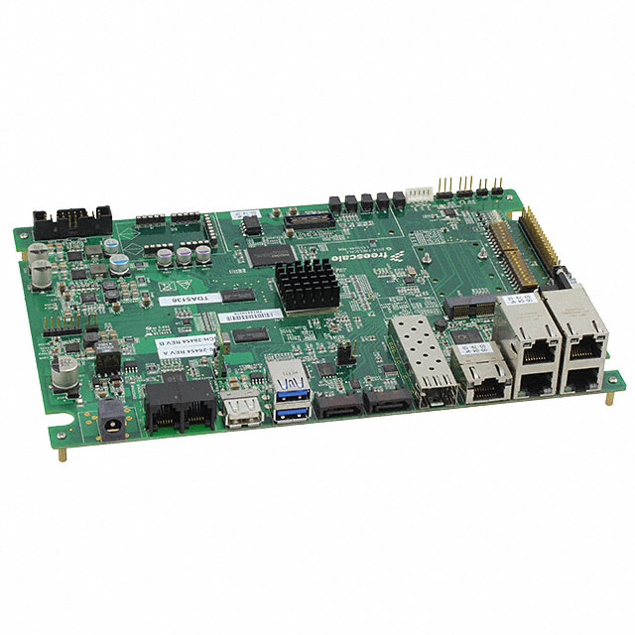


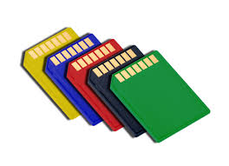
Bootable Removable Media
In development environment, when we have many development boards, sometime it is required to have a removable media containing different OS images, rootfs etc.
It will be good if same removable device can be used with different development boards. . In other words, ‘Bootable Removale Media’, containing multiple OS images.
User can select the device and desired OS images from UEFI boot menu for underlying board for different tests.

Slide 6
Media Layout & Grub Boot Loader
Region 1 (4KB) MBR/GPT Partition Table | Region 2 (50 MB) Partition 1 (FAT16/32) LABEL: EFI BOOTAA64.EFI grub.cfg | Region 3 (300 MB) Partition 2 (EXT4) LABEL: boot Kernel Images | Region 4 (left space of disk) Partition 3 (EXT4) LABEL: rootfs Ubuntu or Ubuntu-Core or CenOS or Debian
Secondary boot loader (GRUB) can be used to locate different OS images and rootfs in the selected boot media.
In Linux environment, fdisk utility can be used to partition and format the target (SD Card/SATA/USB) as per the shown layout and copy the required images (Kernel Images, Rootfs) to the target.
Partition1 (EFI Partition): EFI partition will contains BOOTAA64.EFI (Seconday Boot Loader, GRUB) and its configuration file containing multiple menu entries. User can select the desired menu entry for underlying development board.
Partition2 (Boot Partition): Partition containing the kernel images for different board.
Partition3 (rootfs Patition): Partition containing the common rootfs.

Slide 7
Running Secondary Bootloader
User can run the secondary bootloader (EFI application) by choosing the appropriate entry from UEFI boot menu or Alternatively:
UEFI boot manager has a property to look and run an EFI application with a predefined name (BOOT{machine type short name}.EFI) in /EFI/BOOT location ( EX: BOOTAA64.EFI for arm64) of device. Media should be a FAT32/FAT16 formatted.
This property can be used to run the secondary bootloader (GRUB).
GRUB configuration file can be maintained to locate different OS images and rootfs installed on the media.
Sample Grub Menu Entry:
menuentry ''Linux 4.4 on QorIQ ARM64 LS1043ARDB ' {
set root=(hd3,msdos2)
linux /Image console=ttyS0,115200 root=/dev/mmcblk0p3 rootwait
}
In the environment where multiple devices are connected to board, hard part is setting the root and passing rootfs partition info to OS (to make sure that the OS image and rootds are picked from same selected device).

Slide 8
Finding root and rootfs
Most common methods used with Grub to identify a partition are using LABEL and UUID methods. but they have their own pros and cons.
LABEL Method:
Find boot partition containing OS images.
`search --no-floppy –label boot --set root`
Pass rootfs partition info to OS.
`linux /Image console=ttyS0,115200 root=LABEL=rootfs rootwait`
When using LABEL chances are high that another media contains partitions with same label (specifically for generic names like EFI, boot, rootfs etc)
UUID Method:
Most Used method.
Find boot partition containing OS images.
`search --no-flpartitionoppy --fs-uuid --set c6dc39a1-a7f2-4b75-b1a0-6a681517b8d2`
Pass rootfs info to OS.
`linux /Image console=ttyS0,115200 root=UUID= d6dc39a1-b7f1-5b72-a1a3-9a681517b8d1 rootwait`
But LABEL and UUID information is stored in the filesystem and is not available to the kernel at boot-time.It requires initramfs support so that kernel identify the devices based on UUID/LABEL.
Why to use a initramfs when we have a full rootfs installed on the device. Is there any method to pass rootfs information to OS without using initramfs ?
Yes . Using PARTUUID .

Slide 9
PARTUUID Method
PARTUUID Method:
PARTUUID for all devices are generated and does not change if a partition is formatted.
PARTUUID is stored in the partition table and is available at boot time .Does not required a initramfs.
BUT Grub does not support identifying a partition using PARTUUID.
Solution:
While creating the media layout and partitions on removable device, a dummy file with filename as <PARTUUID of boot partition> can be created in boot partition. In Linux environment ‘blkid’ or ‘lsblk’ utility cab be used to get the PARTUUID.
=>blkid
/dev/sdb1: LABEL="EFI" UUID="5FDD-D666" TYPE="vfat" PARTUUID="3682abcd-01“
/dev/sdb2: LABEL="boot" UUID="19aa40d0-267a-4ff4-adeb-46676044a8fc" TYPE="ext4" PARTUUID="3682abcd-02“
/dev/sdb3: LABEL="rootfs" UUID="012804f3-cce3-4ea9-b679-f8c074b0df86" TYPE="ext4" PARTUUID="3682abcd-03“
=>touch /run/media/sdb2/3682abcd-02
Grub support finding a partition using file-name and set that partition as root.
Find boot partition containing OS images.
`search --no-floppy --file /3682abcd-02 --set root`
Pass rootfs partition info to OS
`linux /Image console=ttyS0,115200 root=PARTUUID=3682abcd-03 rootwait`

Slide 10
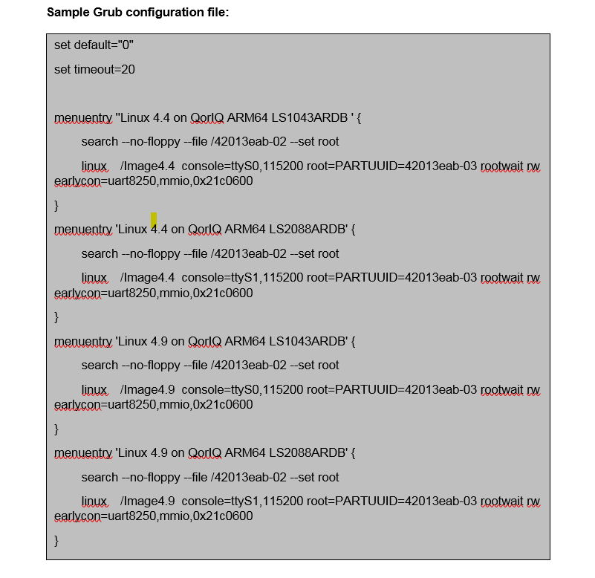
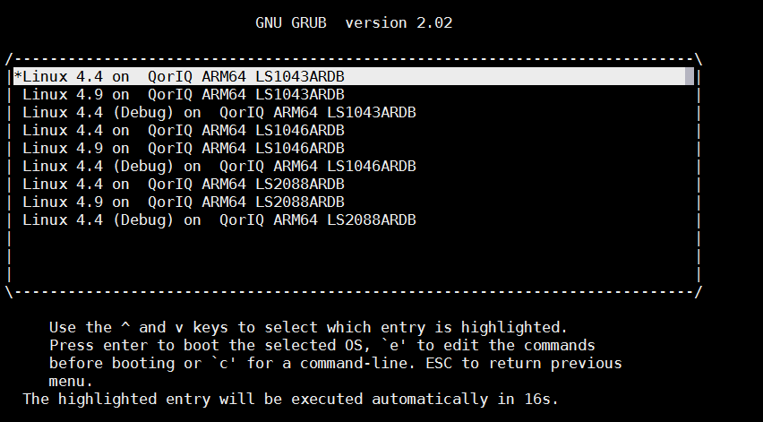
Choose the desired OS image

